Slide 1


Project NLP
Automated Customers Reviews
Dusan Dokic / Tiago Ferreira / Carlos Rodríguez
Data Science & Machine Learning Bootcamp 25/10/2024

Slide 2



LOADING DATA SET
Same data?
We discarded
1429_1.csv
+ 41.000 entries
Datafiniti_[...].csv
5.000 entries
Positive: 3,478 reviews
Neutral: 1,208 reviews
Negative: 314 reviews
Datafiniti_[...]_May19.csv
28,332 entries
Positive: 19,897 reviews
Neutral: 5,648 reviews
Negative: 2,787 reviews
Data Science | Machine Learning

Slide 3
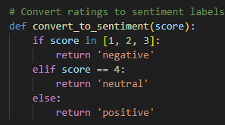

BEFORE PREPROCESSING…
Create a ‘sentiment’ column: numerical ‘ratings’ categorical ‘ratings’
2. Check for missing values
3. Drop useless columns and keep the essential ones for the project:
— reviews.text
— sentiment
— (reviews.rating) optional
— (categories) optional
Data Science | Machine Learning

Slide 4
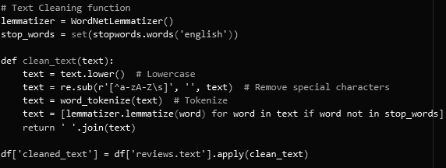
TEXT PREPROCESSING
def clean_text (text):
— Remove special chars
— Remove numbers
— Remove extra white spaces
— Convert to lowercase
— Remove stopwords
— Tokenization
— Lemmatization
Separate function?
def tokenize_and_lematize (text):
Data Science | Machine Learning

Slide 5
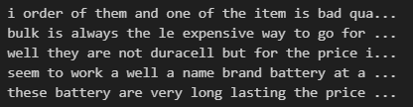




2. MODEL BUILDING…
… BUT FIRST
Train-test split
2. Vectorization: TF-IDF
3. Define hyperparameters
4. Initialize the GridSearchCV
FEATURES | LABELS
Data Science | Machine Learning

Slide 6
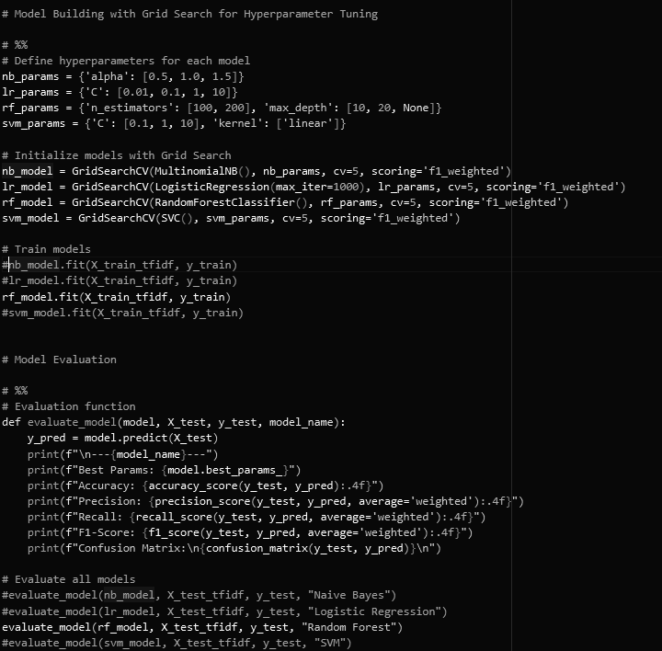
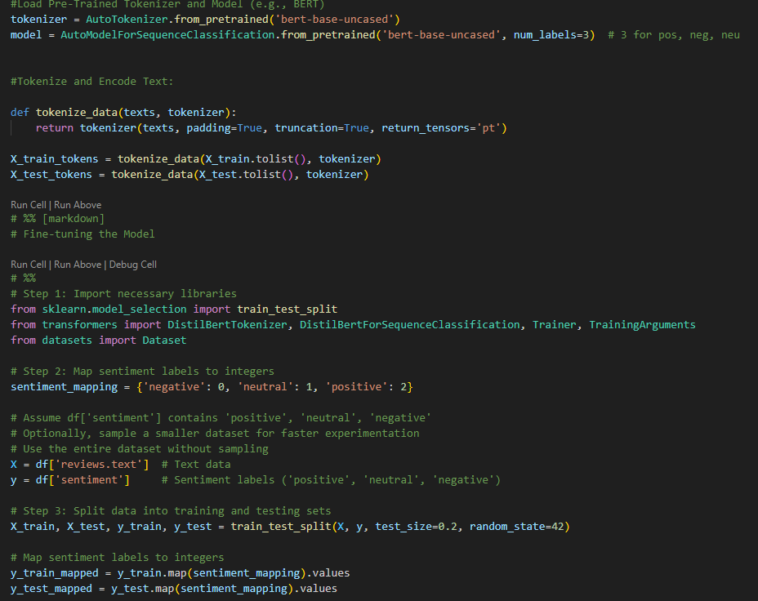
2. MODEL BUILDING TRANSFORMER MODEL
ML MODELs
TRANSFORMER MODEL
Data Science | Machine Learning

Slide 7
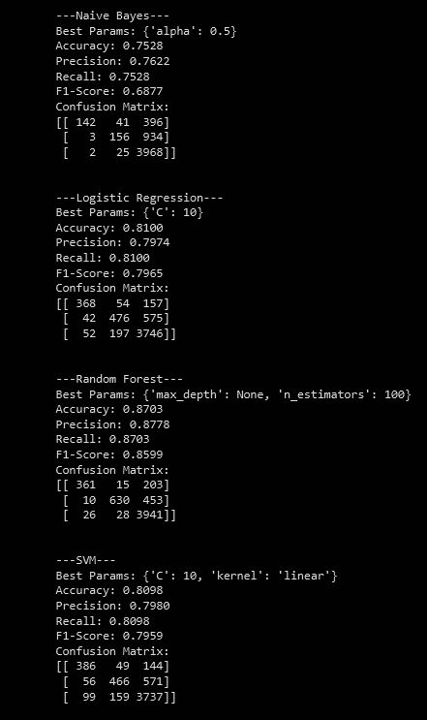
3. MODEL EVALUATION (ML models)
Data Science | Machine Learning

Slide 8
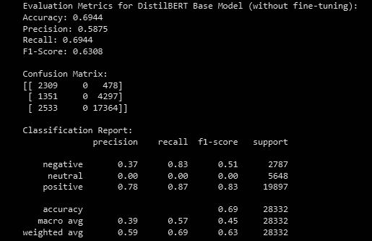
3. MODEL EVALUATION (DistilBert model pre-finetuning)
Used DestilBert from Huggingface
Bad “out-of-the-Box” results
Didn’t get any neutral reviews
Data Science | Machine Learning

Slide 9
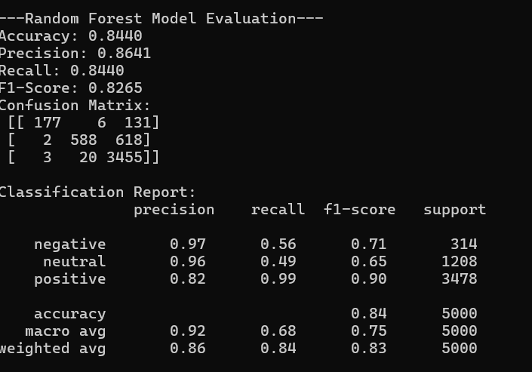
3. MODEL EVALUATION (RandomForest on Eval Dataset)
Evaluated the RF model on a separate Dataset(Datafiniti_[...].csv 5000 rows )
Seemingly good accuracy
Data Science | Machine Learning

Slide 10
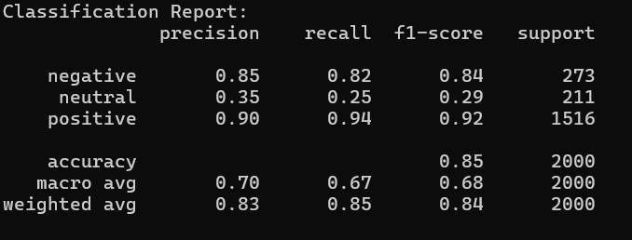
3. MODEL EVALUATION (DistilBert on Eval Dataset)
Evaluated the DistilBert model on a separate Dataset(Datafiniti_[...].csv 5000 rows )
Accuracy is alright for positive and negative cases but this model really struggles with neutral one
Data Science | Machine Learning

Slide 11
https://d445-2003-e6-9f2f-df00-ac09-e1c7-5abe-209e.ngrok-free.app/predict
DEMO

Slide 12
Future Work
To improve the model, the following things could be done:
Balance the dataset out either by removing positive and negative reviews or
Augment the data to have more neutral reviews
Look up a better model on Huggingface to use as a base
Data Science | Machine Learning

